Slide 1
Tec de Monterrey Hello Robot KeyPrediction
Practice 3:
Visual Servoing
Closed-Loop Camera Feedback Control

Slide 2
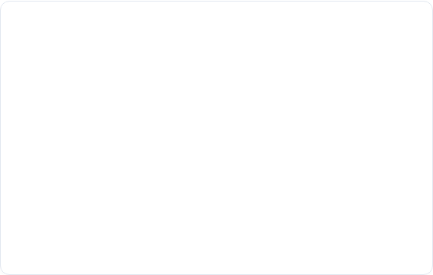
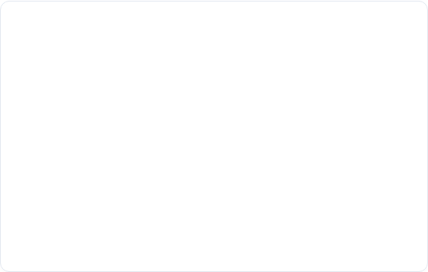
Tec de Monterrey KeyPrediction
Setup & Baseline Control
Repository Update
Part 1: Manual Control
Ensure environment files match upstream changes securely:
Establish a manual control framework in p3_1_manual.py.
git pull
Map hardware velocities via:
uv sync
teleop.get_normalized_velocities()

Slide 3
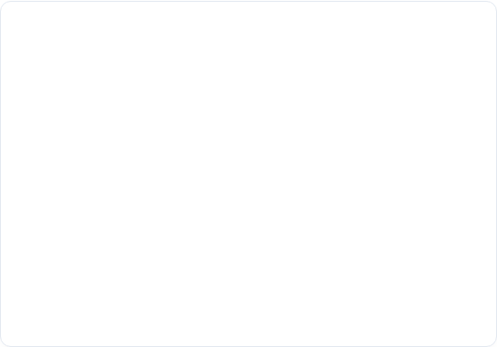

Hello Robot KeyPrediction
Vision Feeds & Color Segmentation
Part 2: Dual Camera Feeds
Part 3: HSV Blue Mask
Open separate, live stream visualization windows inside p3_2_cameras.py:
Isolate target tracking pixels inside p3_3_mask.py using HSV bounds:
• "RGB Camera" window
cv2.inRange(hsv, lower, upper)
• "Depth Camera" window
Displays blue targets as clean, isolated white blobs.

Slide 4

Tec de Monterrey Hello Robot
Part 4: Closed-Loop Tracking
Object Centering Architecture (p3_4_servo.py)
1. Centroid: Locate target mass via cv2.findContours() and cv2.moments().
2. Error: Calculate pixel delta offset from the literal image center framework.
3. Control: Apply proportional scale adjustment gain (Kp = 0.5) to pan/tilt.
4. Blending: Blend manual inputs smoothly via merge_proportional().

Slide 5

Tec de Monterrey Hello Robot KeyPrediction
Submission Requirements
Screen Recording with Voiceover
• Simultaneous display of 3 windows (RGB, Depth, Blue Mask)
• Autonomous head tracking tracking a moving blue object
• Human operator manual override yielding seamlessly
• Oral walkthrough detailing HSV selection & proportional loops

